Slide 1
Microbes
Introduction

Slide 2
What do we know about?
Size? (animace)
Invisible with naked eye
Structure?
Cells (bacteria, fungi, protozoa)
Acellular particles (viruses)
Where are microbes found?
Everywhere:
water – soil – air - organisms

Slide 3
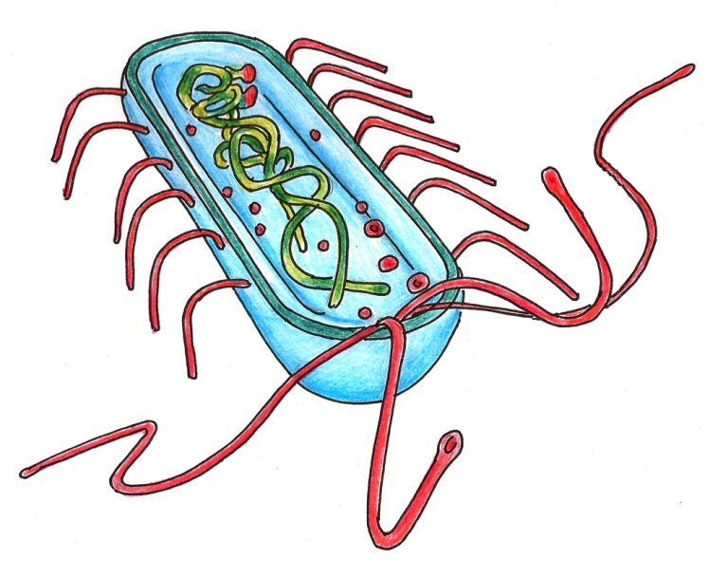
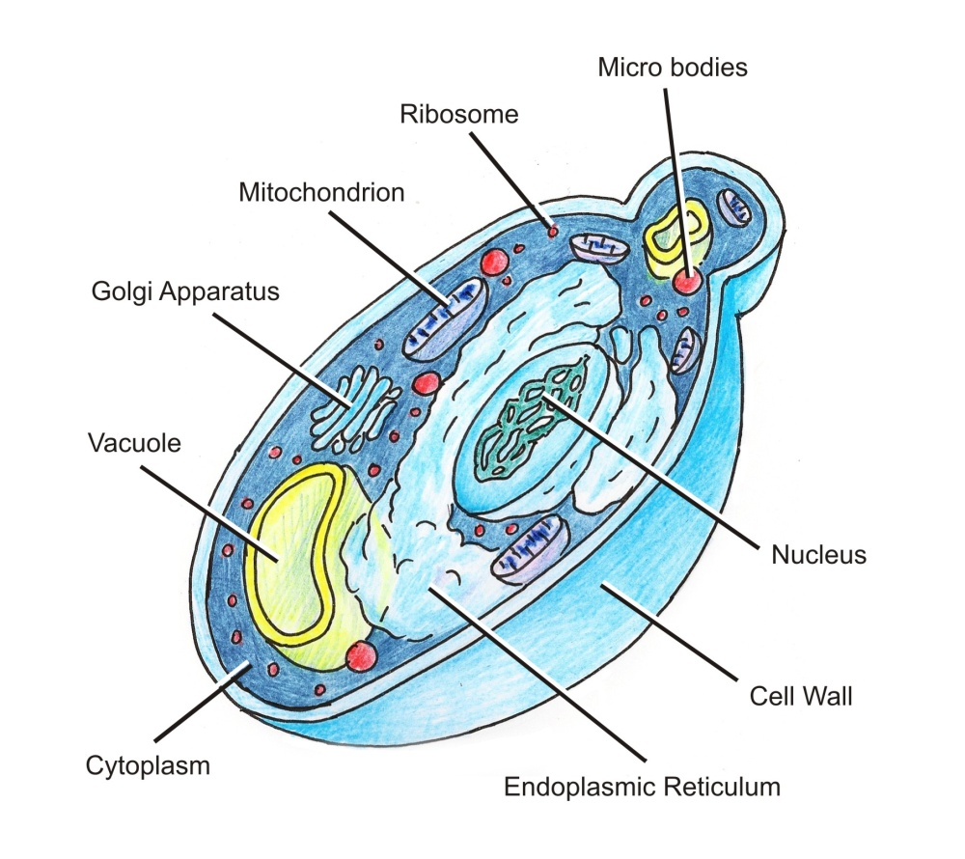
What‘s the difference?
bacteria
Cell wall
Cell membrane
yeast cell
Chromozome (= DNA)
Cytoplasm

Slide 4
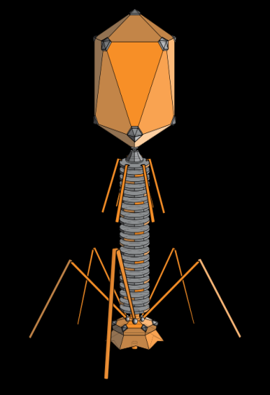
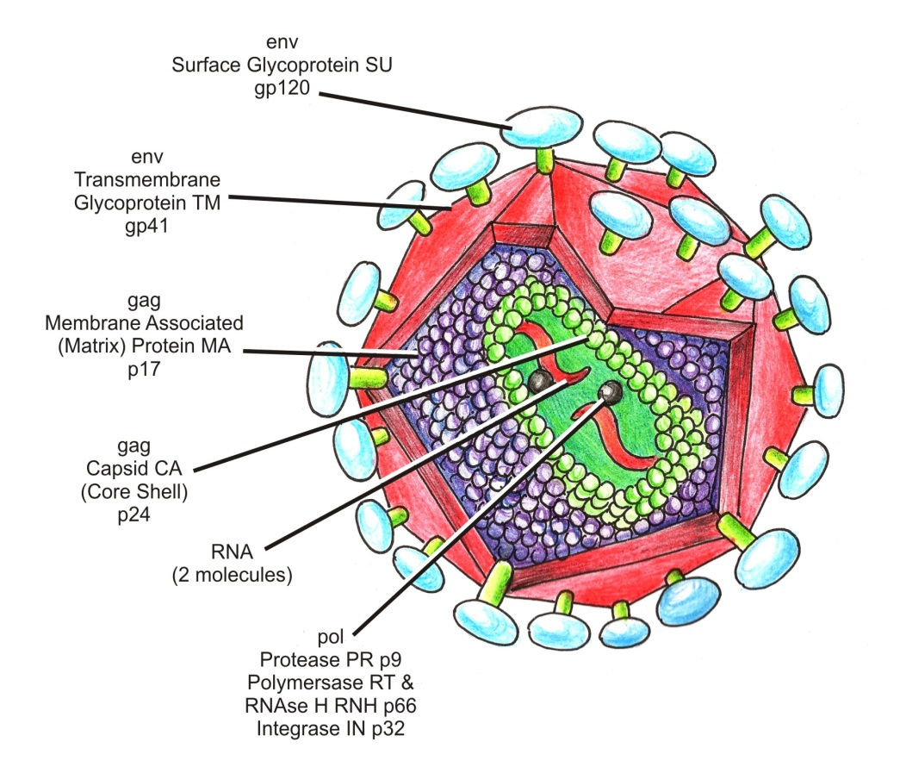
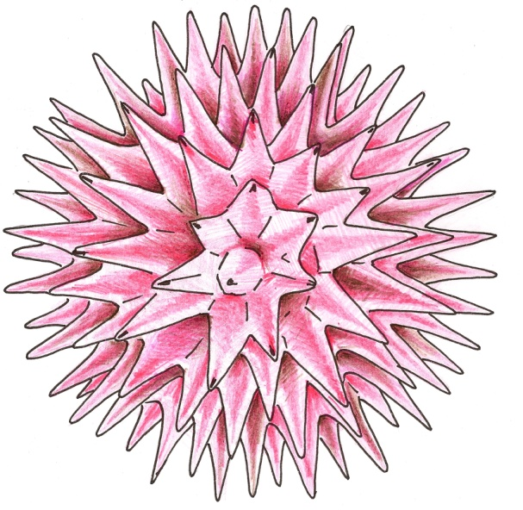
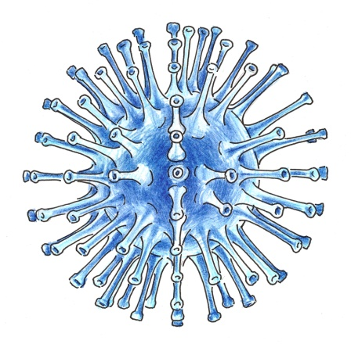
Bacteriophage
– a virus which infects bacteria
Acellular organisms (= viruses)
Viruses are NOT free living – they MUST live inside another living cell
The virus particle consist of nucleic acid (DNA or RNA) and protein capside
HIV
Herpes virus
Influenza

Slide 5
What’s the difference?
Bacteria | Viruses
They need:
Host cell that enables reproduction of virus. (They cannot reproduce by themselves.)
Good (but various) conditions for growth and reproduction.
Nutriens (feed) and some bioelements from their environment
The host cell produces many virus particles, it may completely destroy the host cell.
Suitable temperature.

Slide 6
Bacteria
They are very important as decomposers in all ecosystems.
Most are helpful or harmless, some cause disease. Bacteria can reproduce outside of the body or within the body as they cause infections.
They are found everywhere on earth, in the ocean, in rocks, in volcanoes, in our bodies and in the soil.

Slide 7
Viruses
Viruses are the smallest microbes.
They can infect people, animals, plants, fungi, bacteria.
Most viruses cause diseases.
Notes:
7

